Slide 1
Lowering Costs, Avoiding Risk
An advanced health care strategy
is integral to fiduciary success.

Slide 2



U.S. Health Care System is Failing Employers
Poor Quality
Expensive
Fragmented
Unmanageable Costs
Inconsistent Health Outcomes
Lost Talent and Productivity

Slide 3
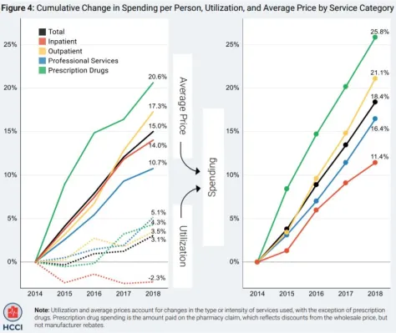
And it is Stacked Against Us
Cumulative Change in Spending per Person, Utilization,
and Average Price by Service Category
Even the largest employers do not have the leverage in the market to adequately drive the current market.
Purchasing health care is a technically complex, multivariate and opaque process.
Traditional intermediaries use the complexity and lack of transparency to price gouge and hide wild variations in quality.
25%
25%
25.8%
20.6%
21.1%
20%
17.3%
20%
18.4%
Average Price
15%
15.0%
15%
16.4%
14.0%
10.7%
11.4%
10%
Spending
10%
5%
5.1%
5%
4.3%
3.5%
Utilization
3.1%
0%
0%
-2.3%
2014 2015 2016 2017 2018
2014 2015 2016 2017 2018
Note: Utilization and average prices account for changes in the type or intensity of services used, with the exception of prescription drugs. Prescription drug spending is the amount paid on the pharmacy claim, which reflects discounts from the wholesale price, but not manufacturer rebates.

Slide 4



New Regulatory Changes Place New Demands On Employers
Health care strategy is key to lowering costs, mitigating risk and protecting company interests.
New federal regulations
Employers’ fiduciary responsibility
Potential for federal penalties and class action lawsuits

Slide 5






























We’re Not Alone

Slide 6
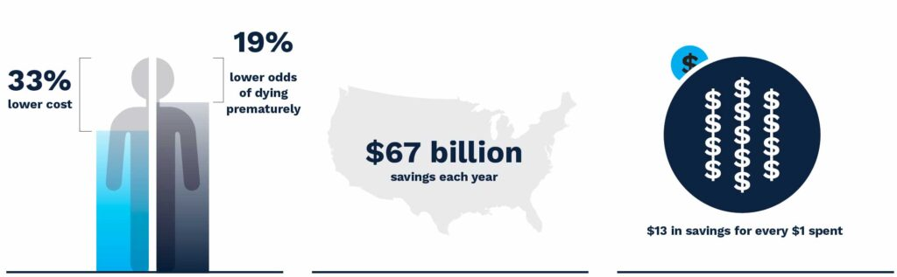
A Clear Primary Care Strategy is Foundational
Primary care lowers costs, decreases premature death and increases productivity.
Despite its benefits:
Primary care accounts for only 35% of ALL health care visits yet influences 90% of total health care spending.
Roughly 4% of U.S. health care dollars are spent on primary care.

Slide 7
What Transformative Advanced Primary Care Can Deliver
For organizations
For employees
Fiduciary success with high-value care
Increased leverage through aggregated purchasing
Actionable transparent performance reporting
Complete data access and analytics
Reduction in total cost-of-care
Employee safety, avoidance of dangerous care and better health quality outcomes
Increased access to care
Better care experience
Healthier, happier employees
Increased presenteeism
Increased productivity
Notes:
The new transparency requirements mandated by the Consolidated Appropriations Act (CAA) will at last give employers access to health care cost data they’ve never before been able to see.
The CAA also reinforces self-insured plan sponsors’ responsibilities as fiduciaries when it comes to health benefits.

Slide 8
Too Few Workers Have Easy Access to Primary Care Provider
Wait time for family medicine appointments:
20.6 Days

Slide 9
Workers Without a Primary Care Provider Come at a Cost
Employees without a PCP cost $3,300 more per patient annually
10,000 employees X $3,000 = $30,000,000

Slide 10

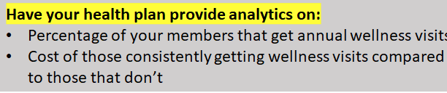
The Value for Our Organization
[PERCENTAGE]% of [YOUR COMPANY] members have annual primary care visits
Members who get an annual visit cost [YOUR COMPANY] an average of $[DOLLARS] per year
Members who do not get an annual visit cost
[YOUR COMPANY] an average of $[DOLLARS] per year
Notes:
Have your health plan provide analytics on:
Percentage of your members that get annual wellness visits
Cost of those consistently getting wellness visits compared to those that don’t

Slide 11
Enter a New Era of Primary Care Excellence
Increased Convenience and Access to High-Quality Primary Care
Simplified Contracting
Transparent Data on Quality
VIP Access Card for Employees
Expert Referrals to Top Specialists
The PBGH Difference:
PBGH is developing a turnkey primary care system of excellence to supplement employers’ existing health plan offerings starting in 2024.

Slide 12
Now is the Time to Act
Our employees are our most valuable asset
We have the tools to support their health and well-being
It will benefit employees and increase our productivity
We can mitigate a new fiduciary risk
We can reduce our total cost-of-care

Slide 13

It’s Time to Take a Different Path
Notes:
Talking points:
Run faster than the industry to drive value
It's a speed game now
Anew route is required
PBGH’s ability to implement has been proven
Ask for redirection for money – plans pay for PBGH
ECEN and Emsana Rx (example) on innovating and selling – moved mission, moved the market, and raised funds

Slide 14
Appendix
Slides that may be added to the presentation

Slide 15
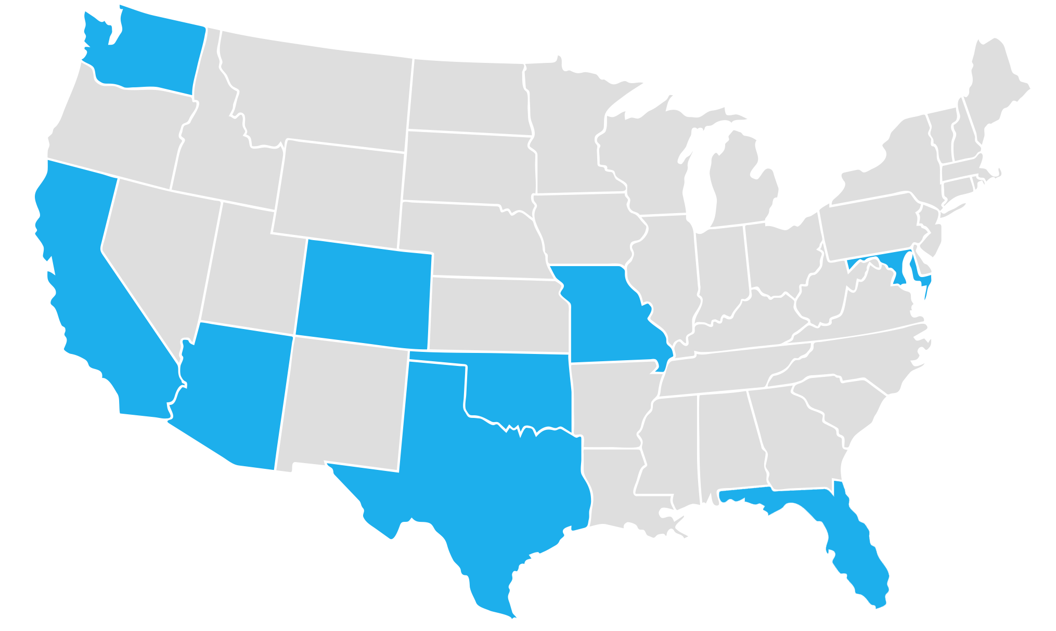


Initial Regions
Puget
Sound
APPROVED
APPROVED
San Francisco
Bay Area
APPROVED
APPROVED
APPROVED
Denver
Arlington/
DC-metro
APPROVED
APPROVED
APPROVED
St. Louis
San Diego
Phoenix/Mesa
Oklahoma
City
APPROVED
APPROVED
Dallas
San Antonio
APPROVED

Slide 16



We Save by Providing Our Employees Superior Access and Service
Identify the best. Raise the bar. Increase access.
PBGH rigorously identifies the highest quality primary and specialty care providers in a community.
PBGH contracts with practices to measure outcomes and drive improvement based on standards set by you and your employees.
Employees receive a
VIP Access Card that triggers benefit incentives and data to encourage and validate access and experience.

